Slide 1
VIT Complaint Connect Team members: Gunjan Gurbani-22BCA0144 Nehul Aggarwal-22BCA0075

Slide 2
Index:
INTRODUCTION 3
Why do we need this website? 4
App Layouts 6
Features and Functionality 18
Benefits 20

Slide 3

Introduction: Our website, [VIT Complaint Connect], is designed to serve as a comprehensive solution for addressing complaints and service requests within the VIT campus community. Our target audience primarily consists of students, faculty, and staff members of VIT, encompassing both academic and administrative concerns. The key objective of our website is to streamline the process of submitting and resolving complaints and service requests, ultimately enhancing the overall experience and satisfaction levels within the campus community. By providing a user-friendly platform for individuals to voice their concerns, seek assistance, and receive timely resolutions, we aim to foster a more supportive and conducive environment for learning, hostel, and campus life at VIT."

Slide 4
Problem Statement
Inefficient handling of student complaints and service requests within the VIT campus community poses a significant challenge, resulting in prolonged resolution times, decreased satisfaction levels, and hindered academic and campus life experiences. There is a pressing need for a centralized, streamlined platform that empowers students to effectively voice their concerns, submit service requests, and receive timely resolutions, thereby enhancing overall campus satisfaction and fostering a more conducive learning and living environment.

Slide 5
Tech Stack
1. Programming Language:
Java: The primary language for Android development before Kotlin became the official language. It’s still widely used for building Android applications.
2. Integrated Development Environment (IDE):
Android Studio: The official IDE for Android development, based on IntelliJ IDEA, providing essential tools like the Android SDK, emulators, and profilers.
3. Android SDK:
Android SDK (Software Development Kit): Provides tools, libraries, and a debugger to build and test Android apps.
Android API Libraries: Used to access Android’s built-in features like cameras, GPS, sensors, notifications, and more.
4. Build Tools:
Gradle: A build automation tool used to compile, test, and package Android apps. Gradle also handles dependency management.
Maven or JCenter: Repositories used to manage external libraries and dependencies.
5. User Interface Design:
XML Layouts: UI in Android is typically defined using XML for static layouts (buttons, text fields, etc.).

Slide 6
App Layouts

Slide 7
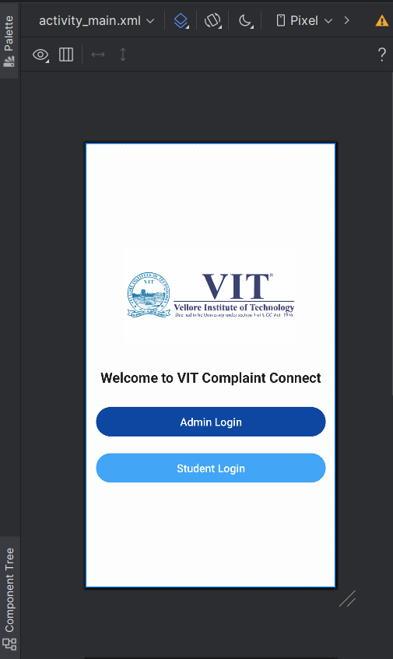

Slide 8
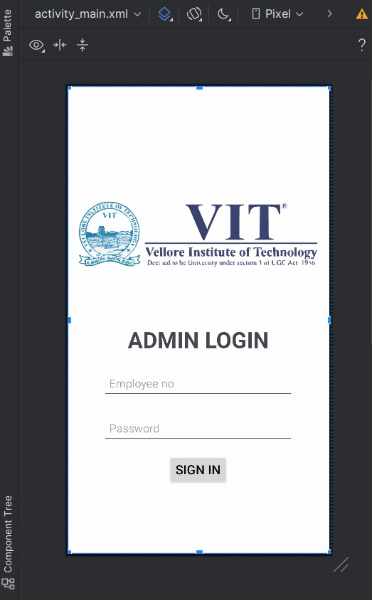

Slide 9
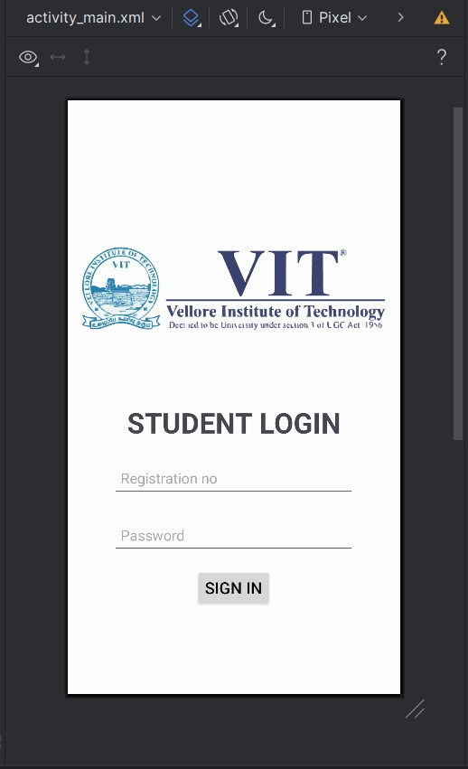

Slide 10
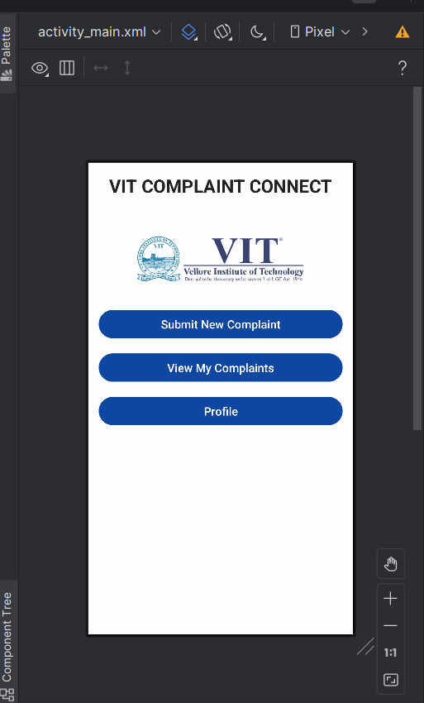

Slide 11
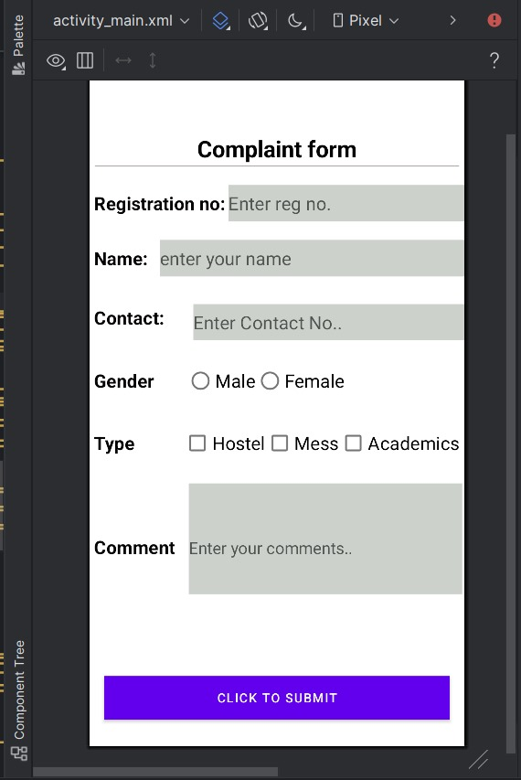

Slide 12
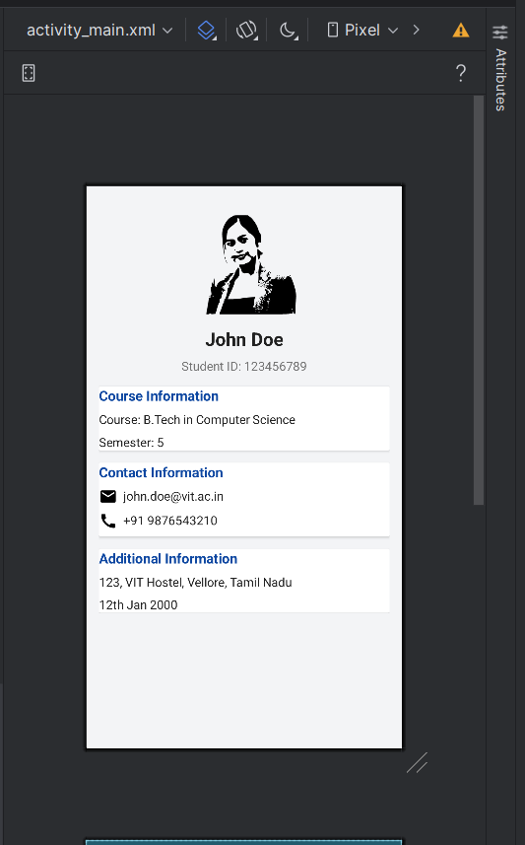

Slide 13
Web Application Layouts

Slide 14
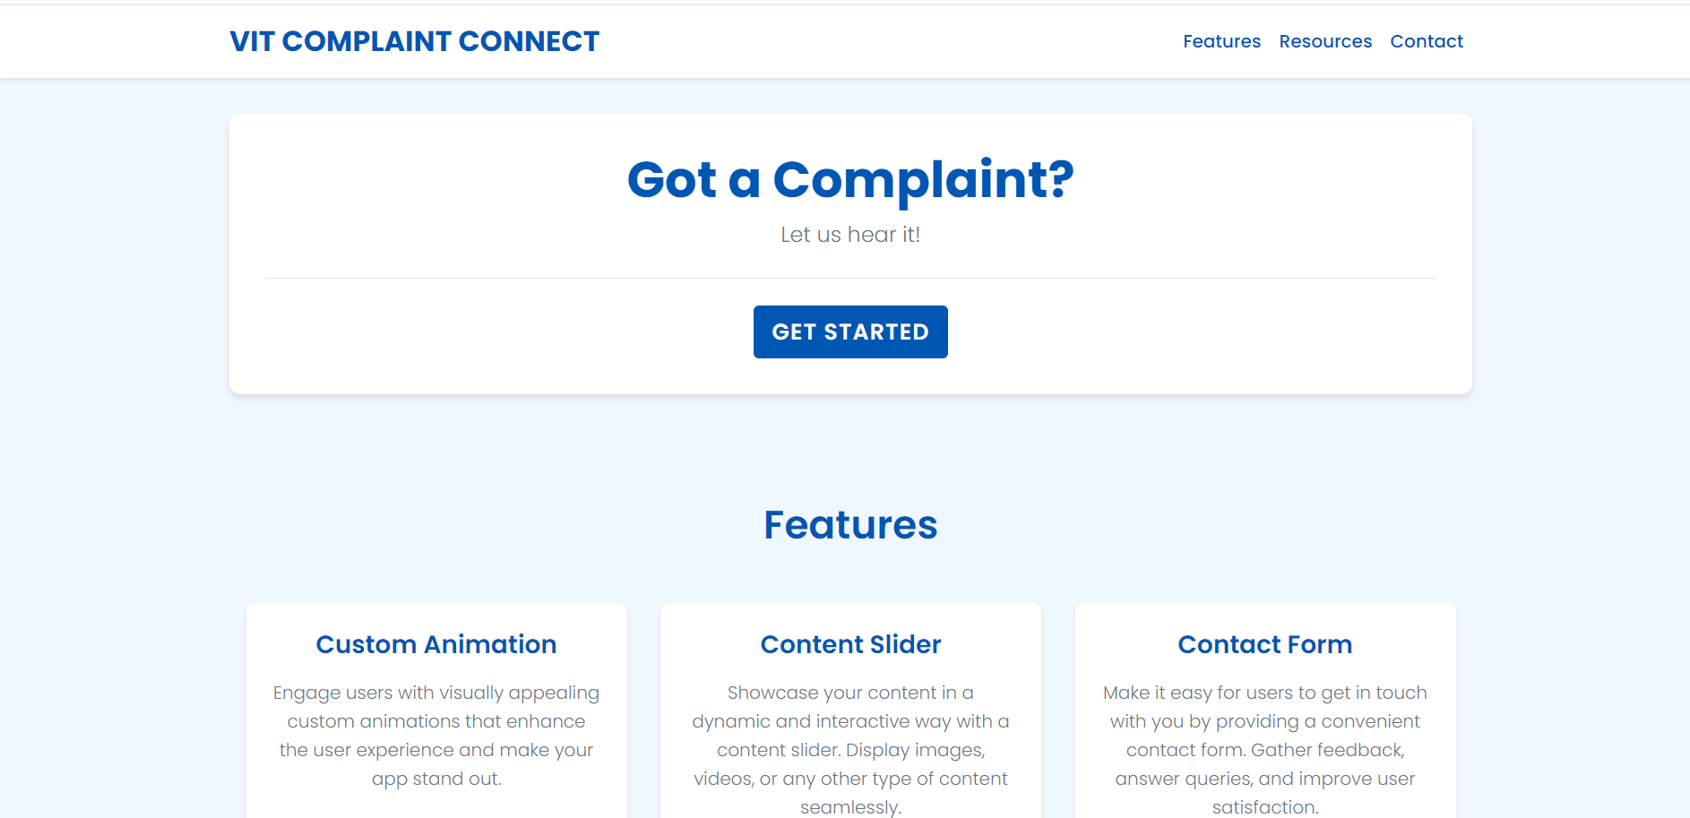

Slide 15
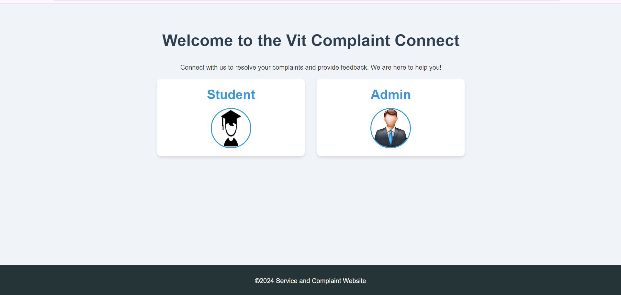

Slide 16
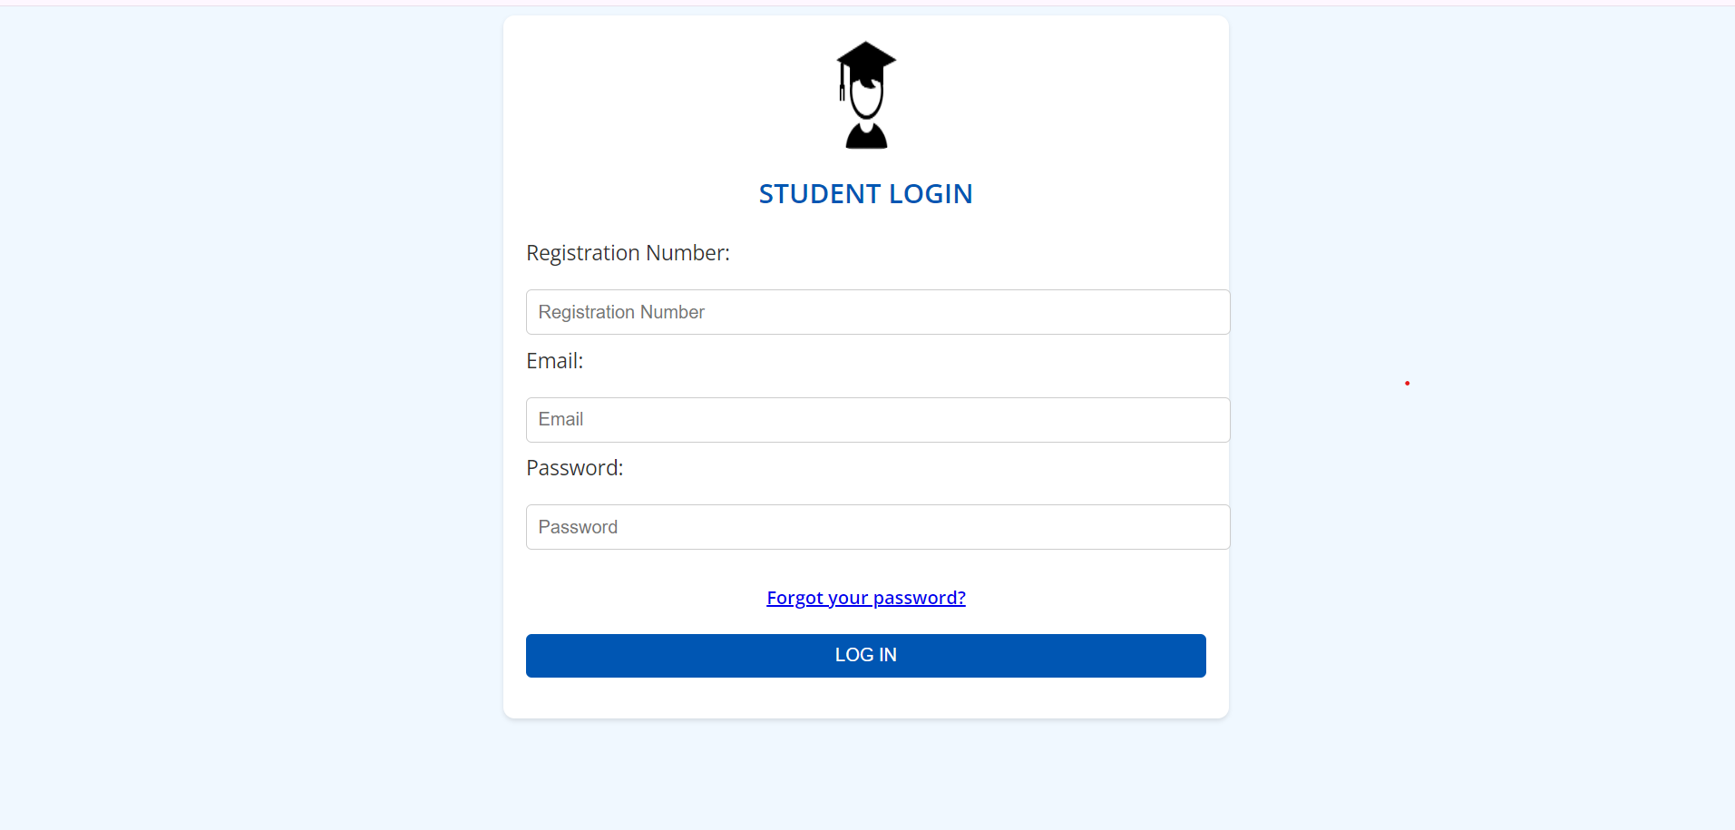

Slide 17
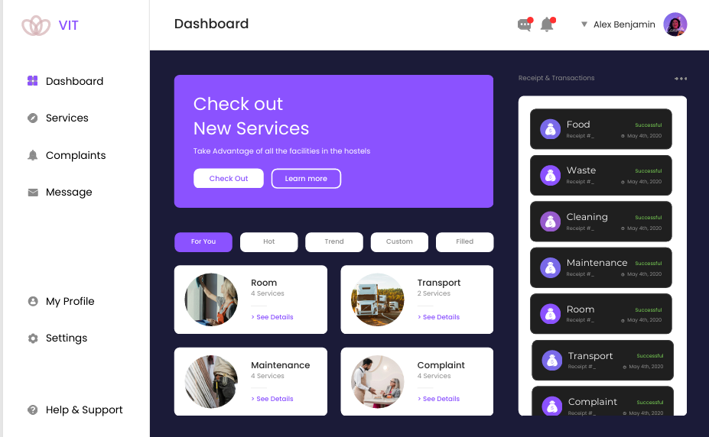

Slide 18
Features and Functionalities
Features and Functionality: Description of the main features and functionality of the website, including:
Complaint submission forms
Service request forms
User registration/login
Tracking the complaint
Services provided
Proper taking care of the mess and hostel facilities.
Ragging and any other such issues.

Slide 19
Unique Features:
Tracking system about how much problem is resolved.
We can bifurcate the different complaints according to their types using filter.
Digitally accessible information regarding our complaints and services.

Slide 20

Benefits
Convenient Complaint Submission Process:
Our website offers a user-friendly interface that allows users to easily submit complaints and service requests from anywhere, at any time, using any device with internet access.
Simplified complaint forms and intuitive navigation streamline the submission process, reducing barriers to voicing concerns.
Quick Resolution of Issues:
Upon submission, complaints and service requests are promptly routed to the appropriate channels for resolution.
Our efficient workflow and communication systems ensure that issues are addressed in a timely manner, minimizing delays and frustrations.
Access to Helpful Resources and Support:
In addition to submitting complaints, users have access to a wealth of helpful resources and support materials, including FAQs, troubleshooting guides, and informational articles.
Live chat support and other assistance channels are available to provide immediate help and guidance to users facing challenges.

Slide 21
Thank you.

